Slide 1
Co-occurrence Matrix
Slides from Dr. Shahera Hossain

Slide 2
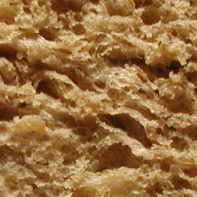
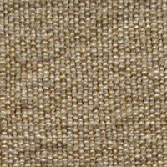
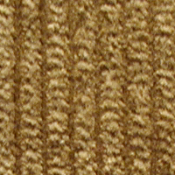
Texture
A texture is an image that follows some statistical properties
It has similar structures repeated over and over again

Slide 3
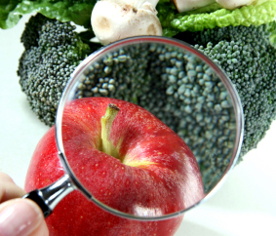
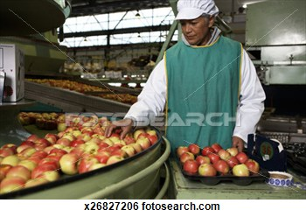
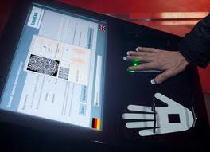
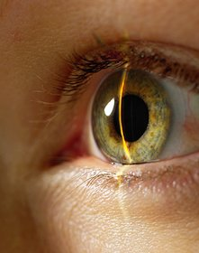
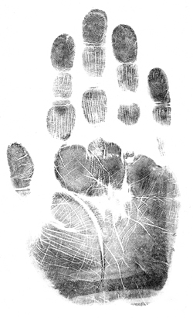
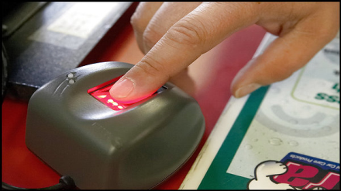
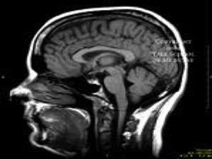
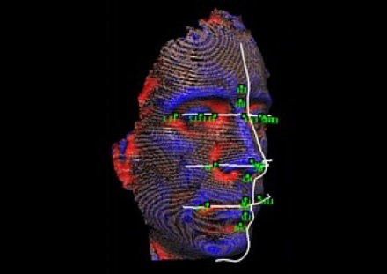
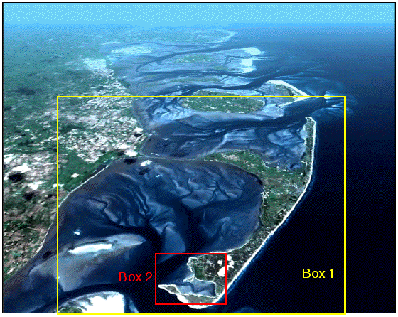
Application Areas of Texture Analysis
Food processing industry
Biometrics analysis (fingerprint, iris or retina, etc.)
Medical image analysis
Global information system (GIS) (for land, etc. analysis)

Slide 4
Flowchart for Texture Analysis
Image Pre-processing
Image selection
Convert into Gray level
1st order
Syntactic
Feature evaluation
Statistical
2nd order
Spectral
Higher order
Manual selection
Average features of same type
PCA
Step-wise discriminant analysis
Fourier,
Wavelet
Feature assortment
LDA
Neural Network
Bayes Decision
Support Vector Machine
Logistic Regression
Decision Trees
K- Nearest Neighbor
Classification
Evaluation
K-means / Hierarchical clustering
Leave – one –out
Test/Training set

Slide 5
Methods for Texture Features
Texture features
Filter
Statistical
Gabor filters
Wavelet
General statistical parameters
Autocorrelation features
Laws texture energy features
Co-occurrence matrix-based features
LBP features
Structural
Model
Fractal features
Random fields features

Slide 6
Statistical: Co-occurrence Matrix-based Features
It is a matrix of frequencies at which → two pixels, separated by a certain vector, occur in the image.
Co-occurrence matrix is defined as,
where,
where,

Slide 7
Computation of Co-occurrence Matrix
It has size N×N (N = Number of gray-values) i.e., the rows & columns represent the set of possible pixel values.
It is computed based on two parameters:
d → Relative distance between the pixel pair
(measured in pixel number. e.g., 1, 2, …)
θ → Relative orientation / rotational angle.
(e.g., 0º, 45º, 90º, 135º, …)

Slide 8
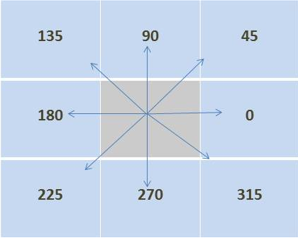
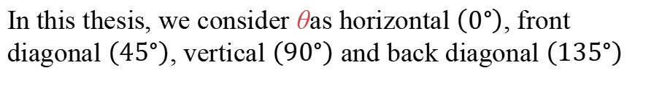
8 Directions/orientations (θ) of Adjacency
In this thesis, we consider θas horizontal $\left(0°\right)$, front diagonal $\left(45°\right)$, vertical $\left(90°\right)$ and back diagonal $\left(135°\right)$

Slide 9
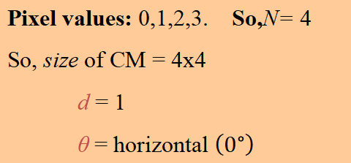
Computation of Co-occurrence Matrix
Find the number of co-occurrences of pixel i to the neighboring pixel value j
Image matrix
0 | 0 | 1 | 1
0 | 0 | 1 | 1
0 | 2 | 2 | 2
2 | 2 | 3 | 3
i/j | 0 | 1 | 2 | 3
0 | #(0,0) | #(0,1) | #(0,2) | #(0,3)
1 | #(1,0) | #(1,1) | #(1,2) | #(1,3)
2 | #(2,0) | #(2,1) | #(2,2) | #(2,3)
3 | #(3,0) | #(3,1) | #(3,2) | #(3,3)
Pixel values: 0,1,2,3. So,N= 4
So, size of CM = 4x4
d = 1
θ = horizontal $\left(0°\right)$

Slide 10
Example: Computation (contd.)
i/j | 0
0 | #(0,0)
d = 1 θ = horizontal $\left(0°\right)$
0 | 0 | 1 | 1
0 | 0 | 1 | 1
0 | 2 | 2 | 2
2 | 2 | 3 | 3
2

Slide 11
Example: Computation (contd.)
d = 1 θ = horizontal $\left(0°\right)$
0 | 0 | 1 | 1
0 | 0 | 1 | 1
0 | 2 | 2 | 2
2 | 2 | 3 | 3
2 | 2 | 1 | 0
Image
CM for the Image
i/j | 0 | 1 | 2 | 3
0 |  | #(0,1) | #(0,2) | #(0,3)
1
2
3

Slide 12
Example: Computation (contd.)
d = 1 θ = horizontal$\left(0°\right)$
0 | 0 | 1 | 1
0 | 0 | 1 | 1
0 | 2 | 2 | 2
2 | 2 | 3 | 3
2 | 2 | 1 | 0
0 | 2 | 0 | 0
0 | 0 | 3 | 1
0 | 0 | 0 | 1
Image
CM for the Image
i/j | 0 | 1 | 2 | 3
0 | #(0,0) | #(0,1) | #(0,2) | #(0,3)
1 | #(1,0) | #(1,1) | #(1,2) | #(1,3)
2 | #(2,0) | #(2,1) | #(2,2) | #(2,3)
3 | #(3,0) | #(3,1) | #(3,2) | #(3,3)

Slide 13
Example: Computation (contd.)
d = 1 θ = vertical$\left(90°\right)$
0 | 0 | 1 | 1
0 | 0 | 1 | 1
0 | 2 | 2 | 2
2 | 2 | 3 | 3
3 | 0 | 2 | 0
0 | 2 | 2 | 0
0 | 0 | 1 | 2
0 | 0 | 0 | 0
Image
CM for the Image
i/j | 0 | 1 | 2 | 3
0 | #(0,0) | #(0,1) | #(0,2) | #(0,3)
1 | #(1,0) | #(1,1) | #(1,2) | #(1,3)
2 | #(2,0) | #(2,1) | #(2,2) | #(2,3)
3 | #(3,0) | #(3,1) | #(3,2) | #(3,3)

Slide 14
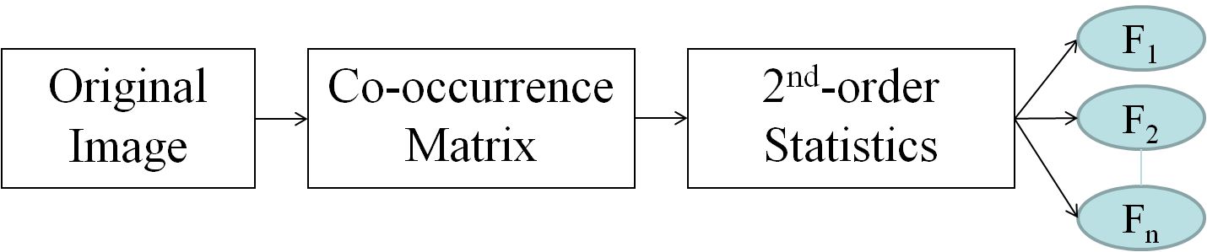
Features on co-occurrence matrix
- Co-occurrence matrices capture properties of a texture
- But they are not directly useful for further analysis
(e.g., comparison of two textures)
11 Numeric features are computed from a matrix

Slide 15
Features on co-occurrence matrix (contd.)
F1 → Angular Second Moment (ASM) feature
F2 → Contrast feature
F3 → Entropy feature
F4 → Variance feature
F5 → Correlation feature
F6 → Inverse Difference Moment (IDM) feature
F7 → Sum Average feature
F8 → Sum Variance feature
F9 → Sum Entropy feature
F10 → Information Measures of Correlation feature – 1 (IMC1)
F11 → Information Measures of Correlation feature – 2 (IMC2)

Slide 16
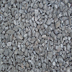




Features on co-occurrence matrix (contd.)
Co-occurrence Matrices
(d,θ) = (1,$0°$)
Angular Second Moment (ASM) feature
Contrast feature
Entropy feature
Variance feature
Correlation feature
Inverse Difference Moment (IDM) feature
Sum Average feature
Sum Variance feature
Sum Entropy feature
Information Measures of Correlation feature – 1
Information Measures of Correlation feature – 2
Input image
Feature Vector
(d,θ) = (1,$45°$)
(d,θ) = (1,$90°$)
(d,θ) =(1,$135°$)

Slide 17
Feature | Comment
F2: Contrast | - Have discriminating ability. - Rotationally-variant.
F3: Entropy | - Have strong discriminating ability. - Almost rotational-invariant.
F4: Variance | - Have discriminating ability. - Rotational-invariant.
F5: Correlation | - Have strong discriminating ability. - Rotational-dependent feature.
top

Slide 18
Feature | Comment
F7: Sum average | - Characteristics are similar to ‘variance’/F4 - Rotational-invariant.
F10: Information Measure of Correlation–1 | - It has almost similar pattern of ‘sum average’/F7 but vary for various classes - Varies significantly with rotation
F11: Information Measure of Correlation–2 | - It is computationally expensive compare to others. - Rotation-variant

Slide 19
Feature | Comment
F1: Angular Second Moment / Energy | - No distinguishing ability
F6: Inverse Different Moment | - Similar to ‘angular second moment’/F1
F8: Sum Variance | - Similar to ‘variance’/F4
F9: Sum Entropy | - Similar to ‘entropy’/F3

Slide 20
Thank you very much for your kind attention

